Slide 1
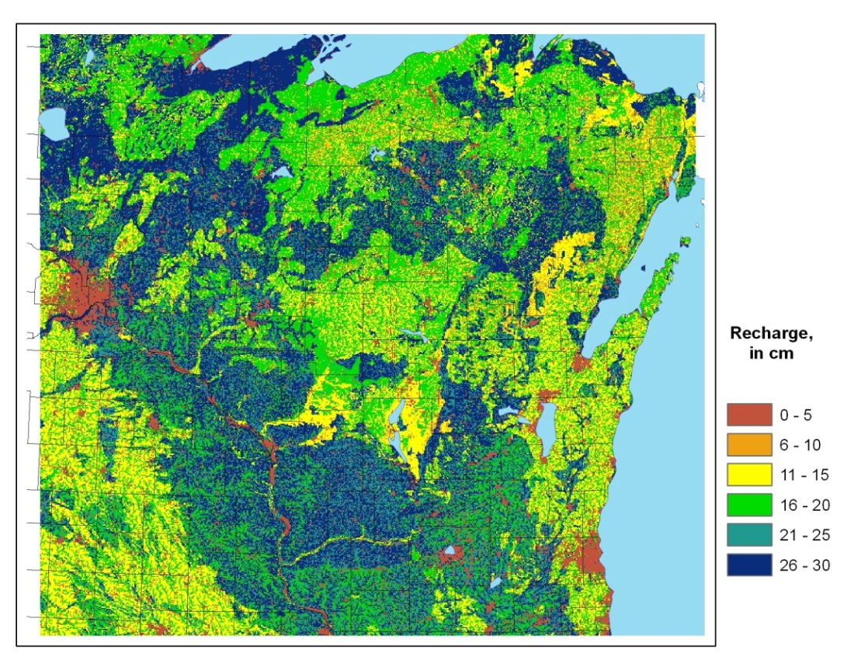
August 6, 2012 Steve Westenbroek Wisconsin Water Science Center
Theory and application of
swb
(Soil-Water-Balance Model)

Slide 2
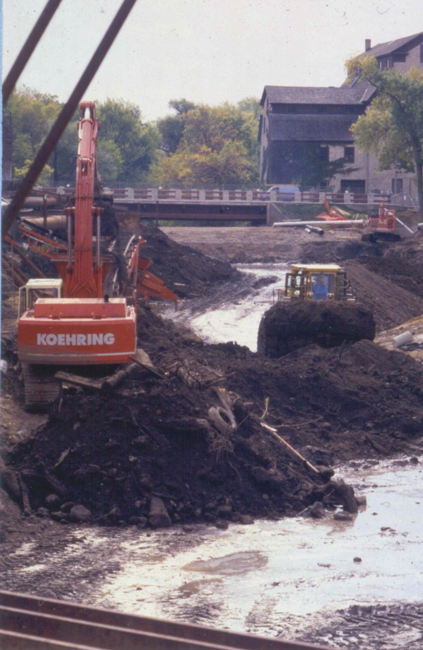
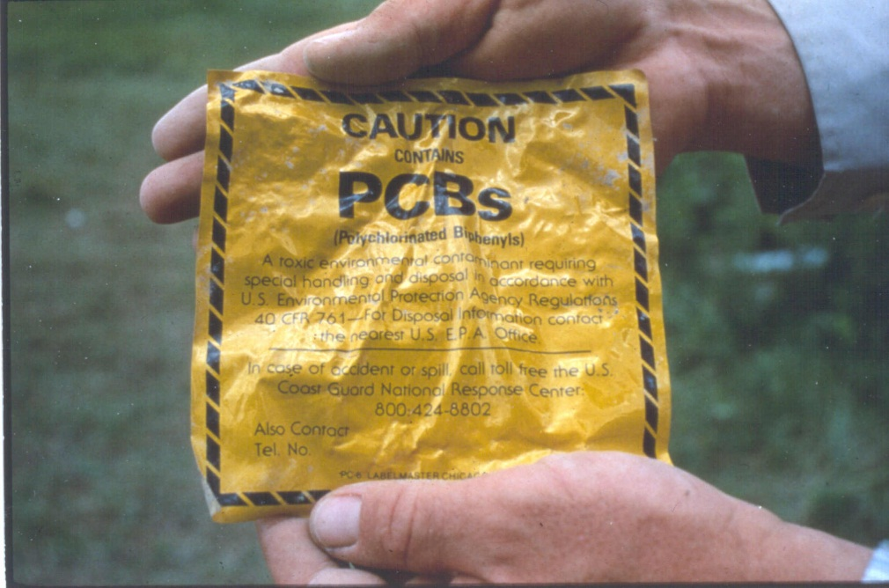
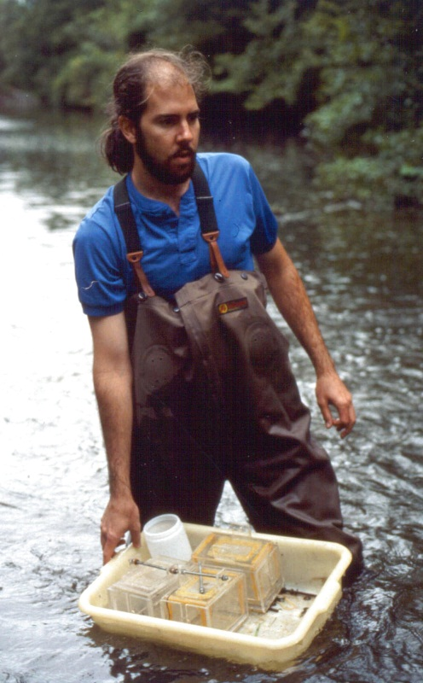
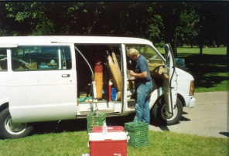
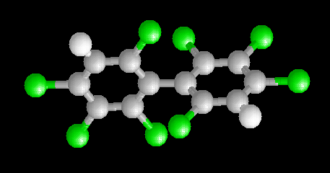
contaminated sediments

Slide 3
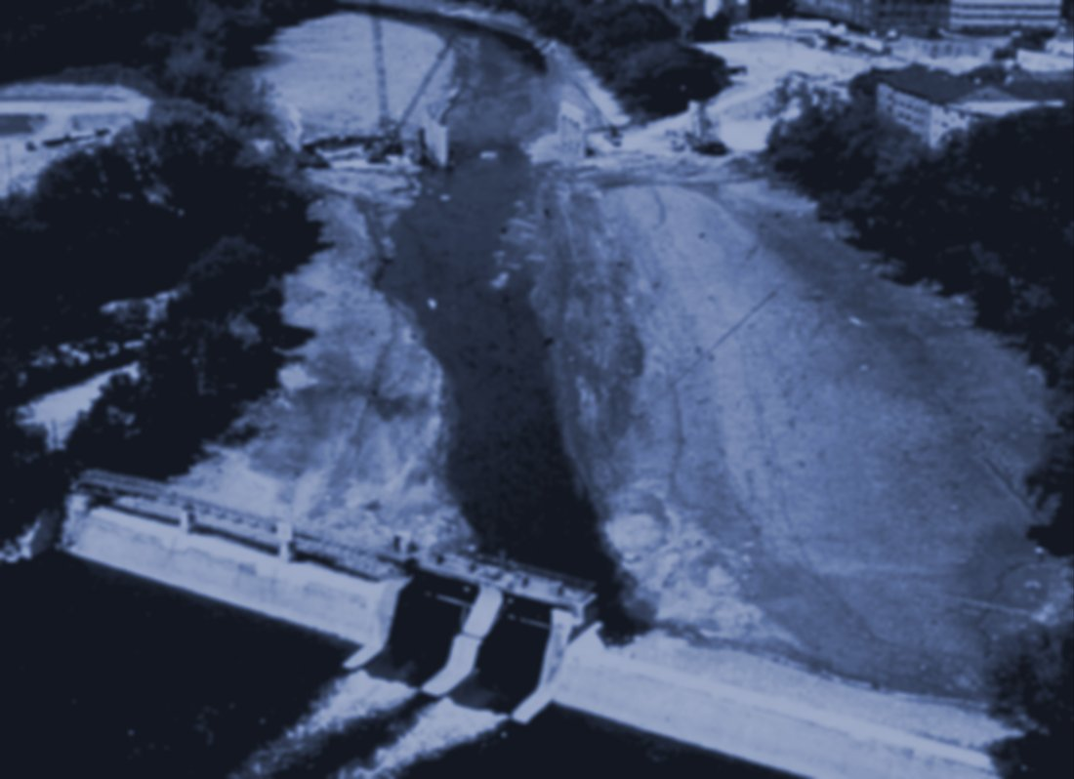
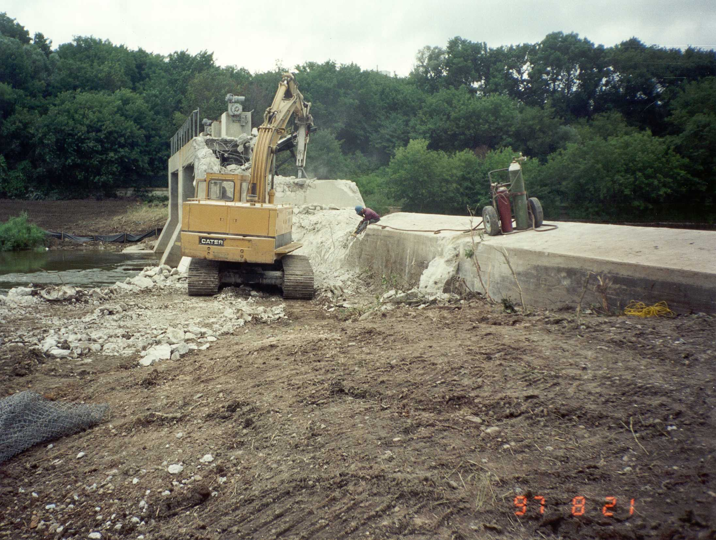
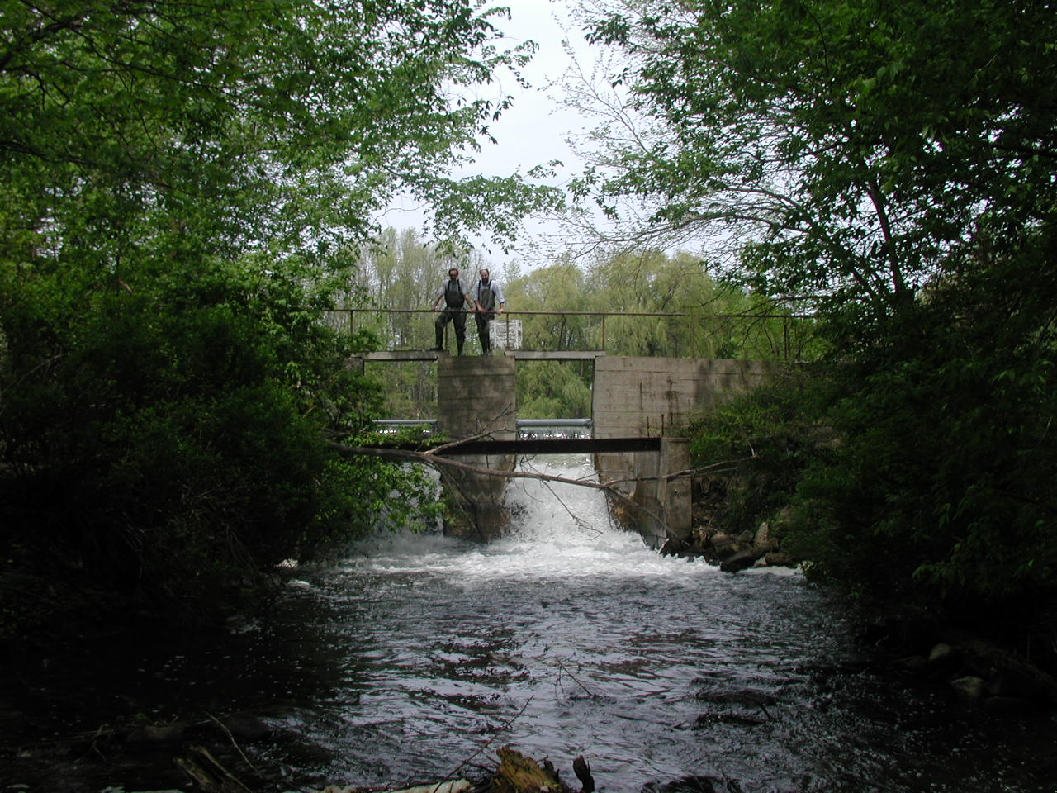
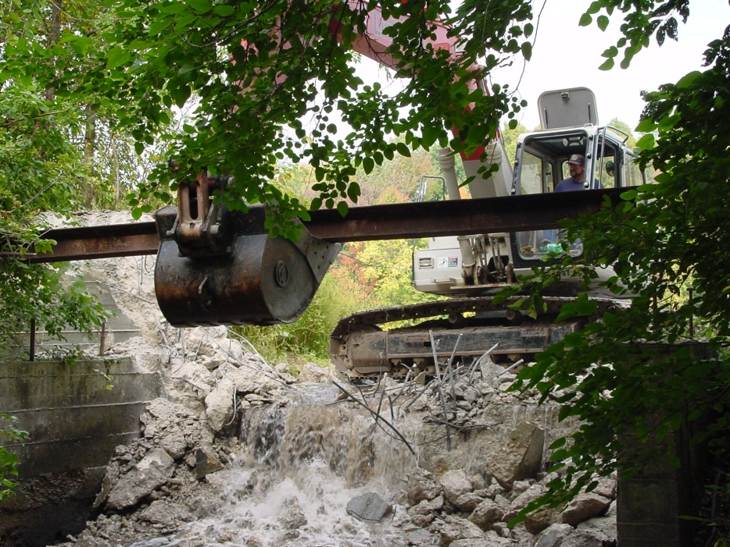
dam removals

Slide 4
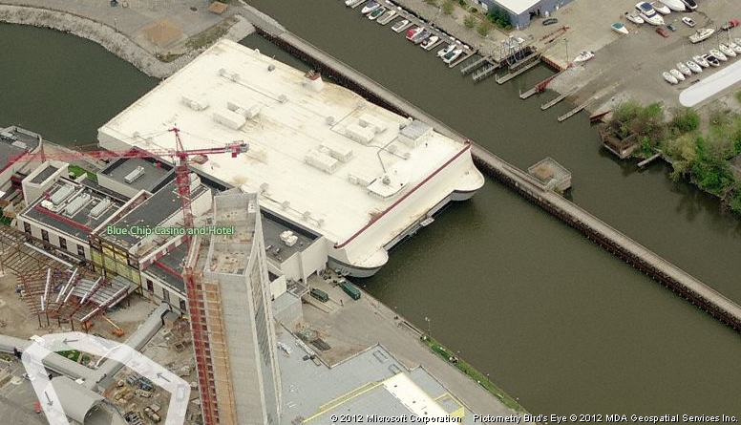
building casinos(!)

Slide 5
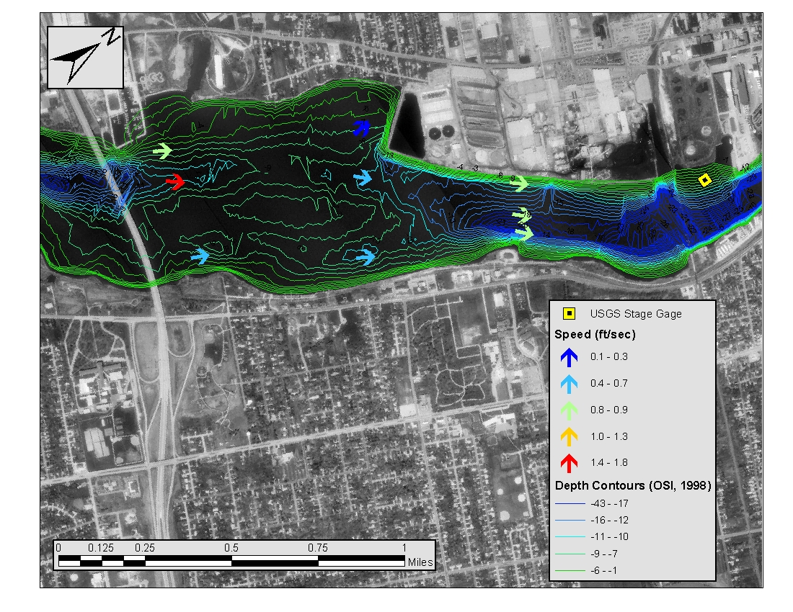
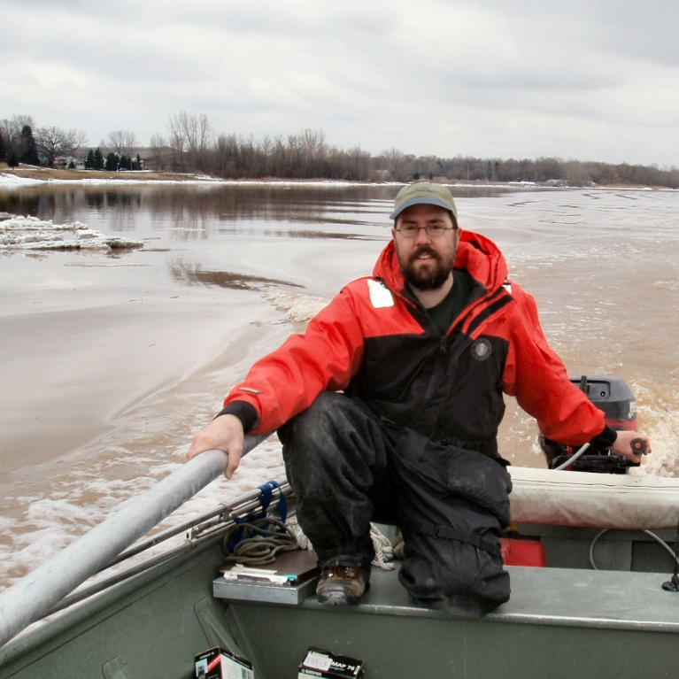
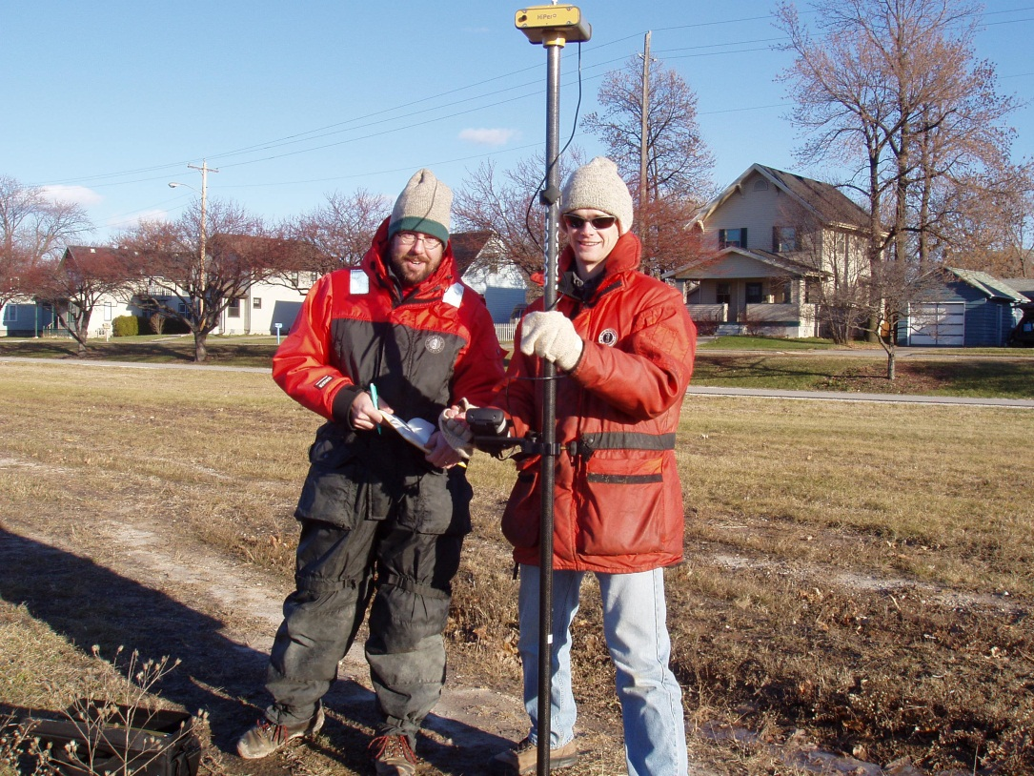
shear stress studies

Slide 6
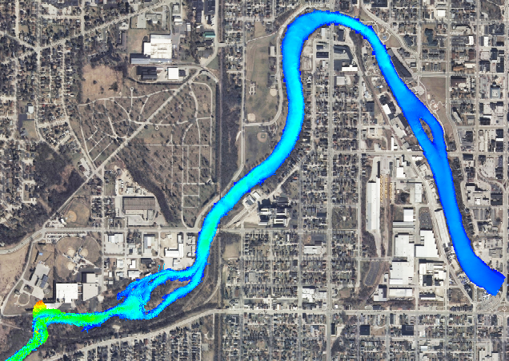
hydrodynamic modeling

Slide 7
soil-water-balance model
_d:\SMWData\Source_Code\SWB_TEST_CASES\Coshocton\swb>swb
Soil Water Balance Code version 1.1 -- compiled on: Aug 5 2012 11:48:06
Compiled with: GNU gfortran version 4.6.2
Compilation options:
----------------------------------
STREAM_INTERACTIONS no
GRAPHICS_SUPPORT yes
NETCDF_SUPPORT yes
STRICT_DATE_CHECKING no
THORNTHWAITE_MATHER_TABLE yes
DEBUG_PRINT no
Usage: swb [control file name]

Slide 8
part 1: introduction and capabilities
what is swb?
what kinds of problems has swb been used for?
what are the positives of swb?
what are the negatives of swb?
how does it compare to other similar tools?

Slide 9
part 2: under the hood
Thornthwaite-Mather methodology
mechanisms used to simulate components of the water balance

Slide 10
part 3: simple application example
data sources
data wrangling
gridded data
tabular data
other considerations:
grid cell resolution
representation of land use and soils

Slide 11
part 4: tools, tips, and tricks for more advanced applications
gridded precipitation and temperature grids
netCDF(!)
PEST
use of irrigation module
accessing swb output:
swbstats, R/Python modules
what to do when swb bombs

Slide 12
part 4.5: future of swb
Doxygen and documentation
GitHub and collaboration
@TODO list
features vs. performance

Slide 13
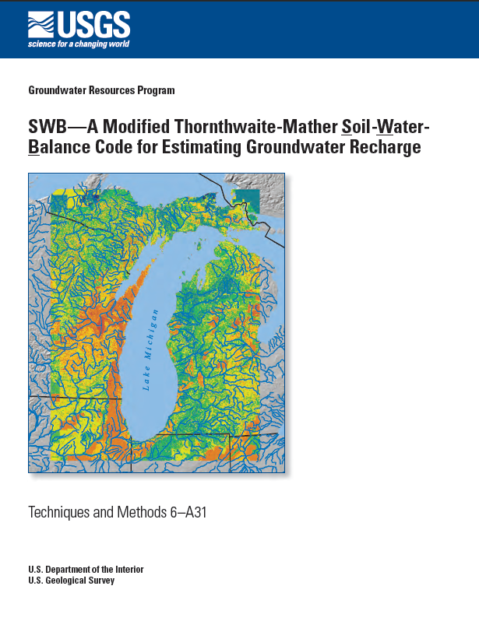
what is swb?
grid-based
modified Thornthwaite-Mather approach
daily timestep
accounts for:
snow accumulation / melting
runon / runoff
interception
evapotranspiration
runoff from frozen ground
http://pubs.usgs.gov/tm/tm6-a31/

Slide 14
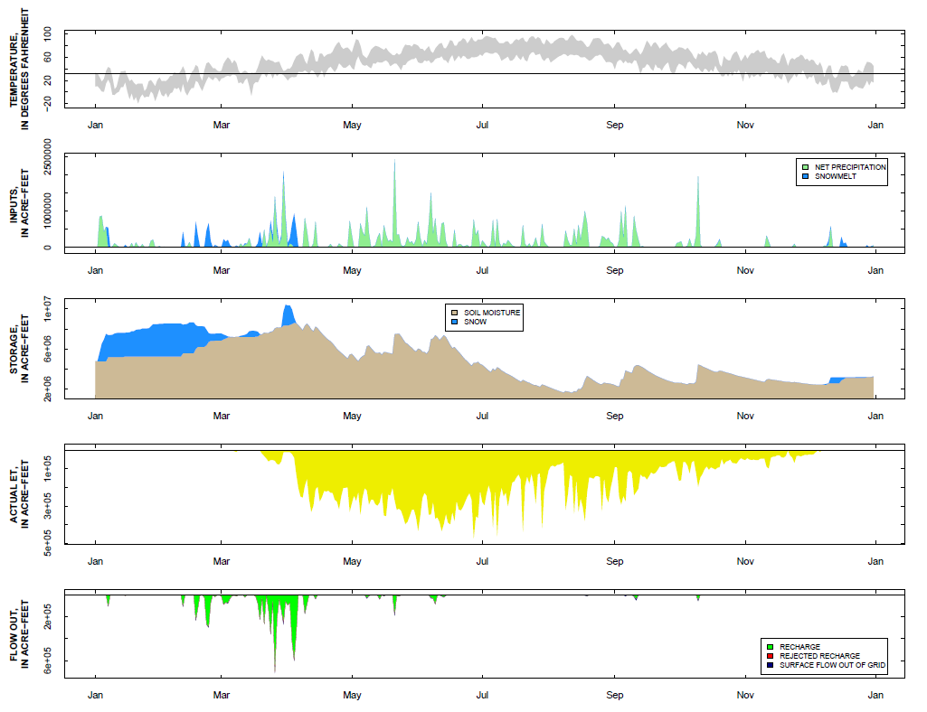
Performs water balance for each grid cell

Slide 15
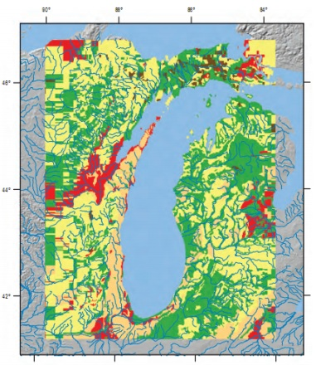
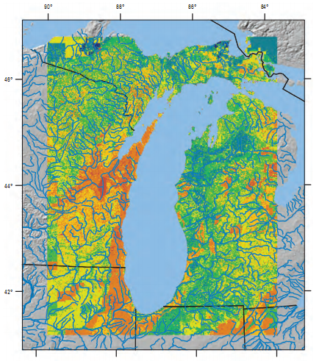
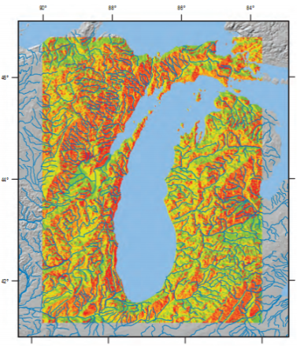
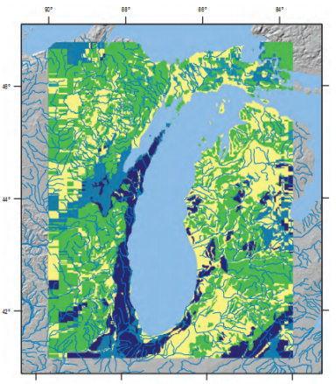
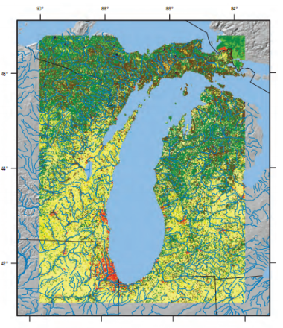
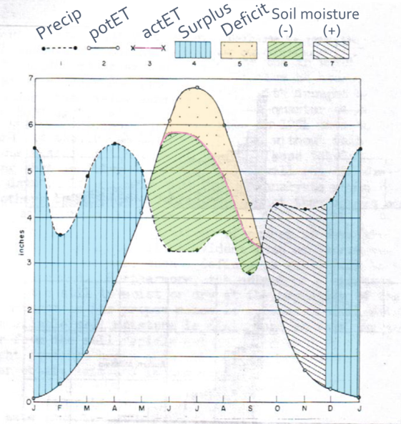
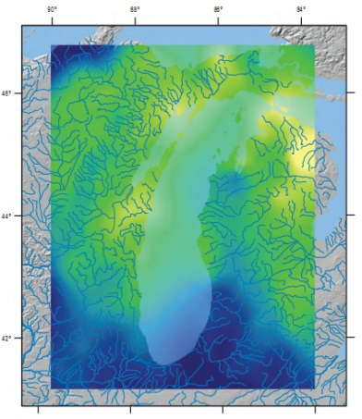
swb is easy to begin using
Potential recharge
Soil hydrologic group
D8 flow direction
Available water
content
Land use / land
cover
swb
Gridded or tabular
daily precipitation, minimum
and maximum air temperature

Slide 16
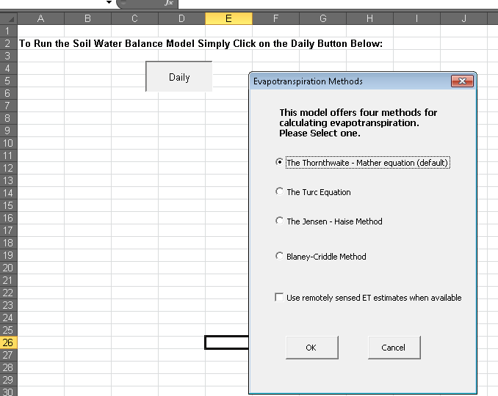
swb designed from the start for groundwater problems
Source: Dripps, 2003

Slide 17
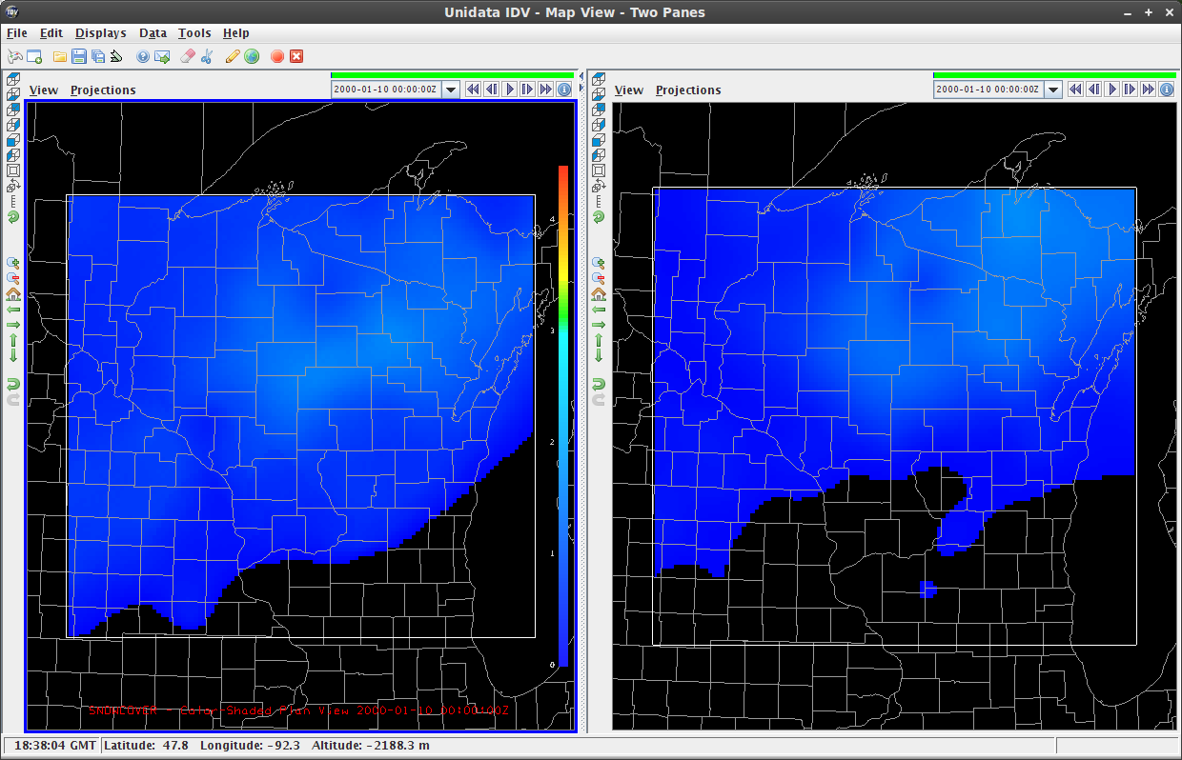
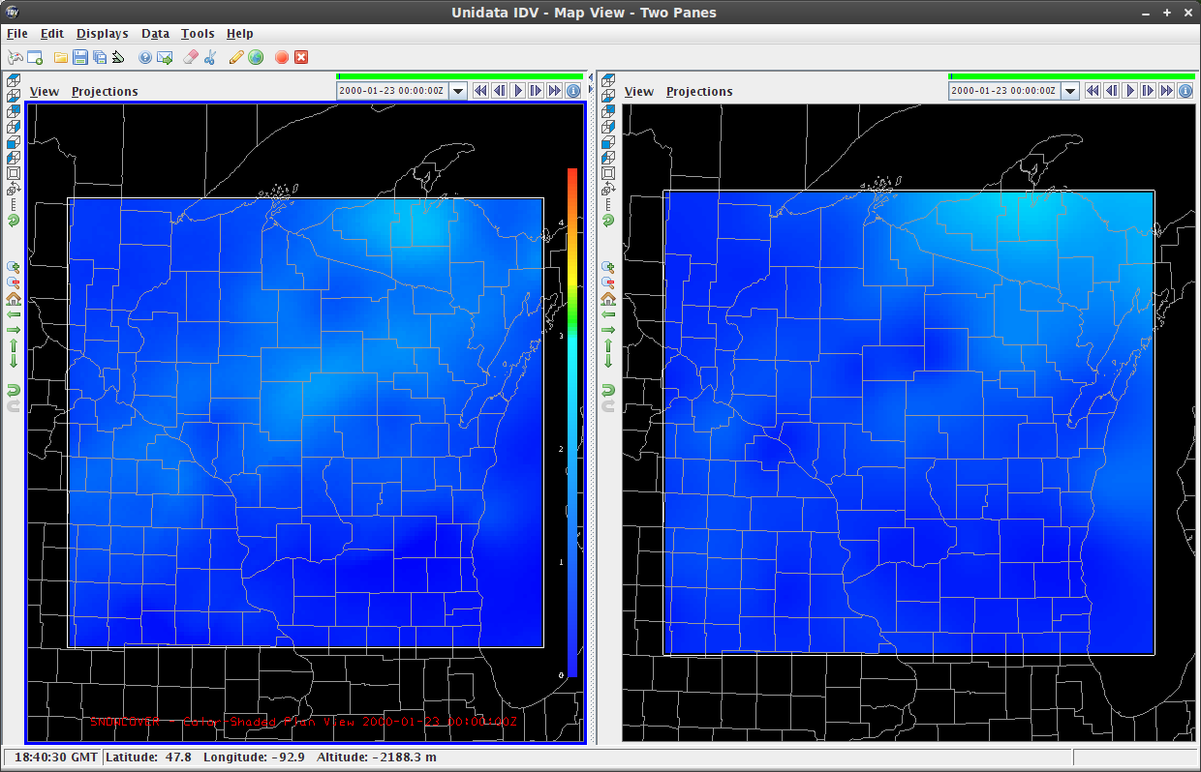
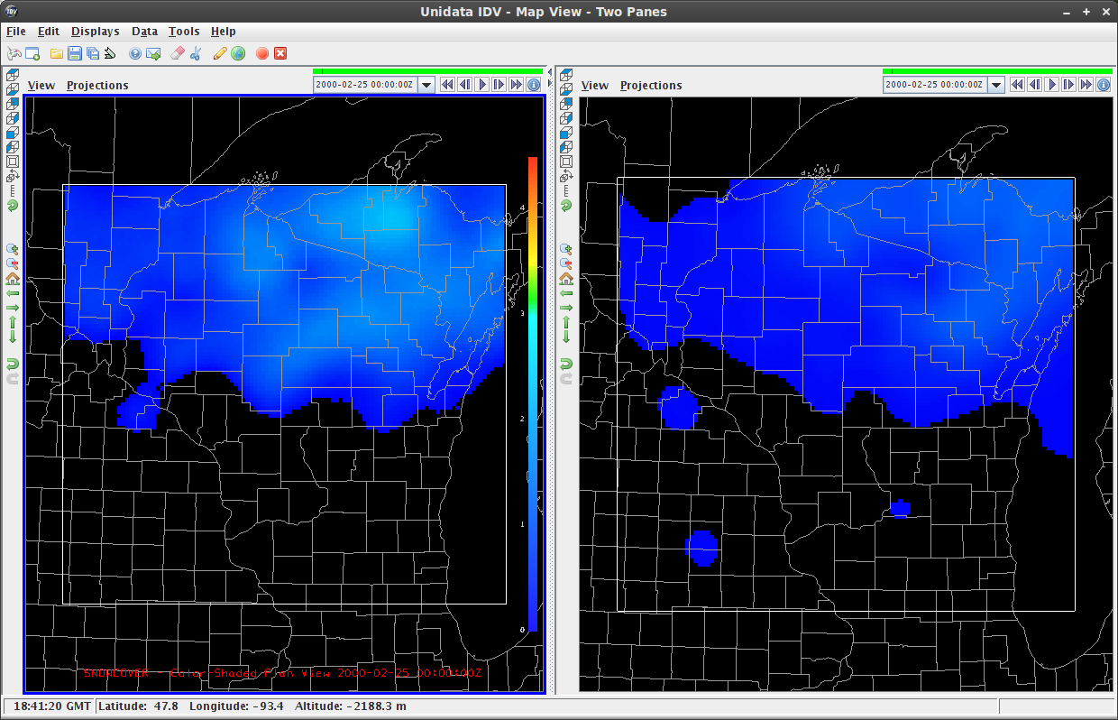
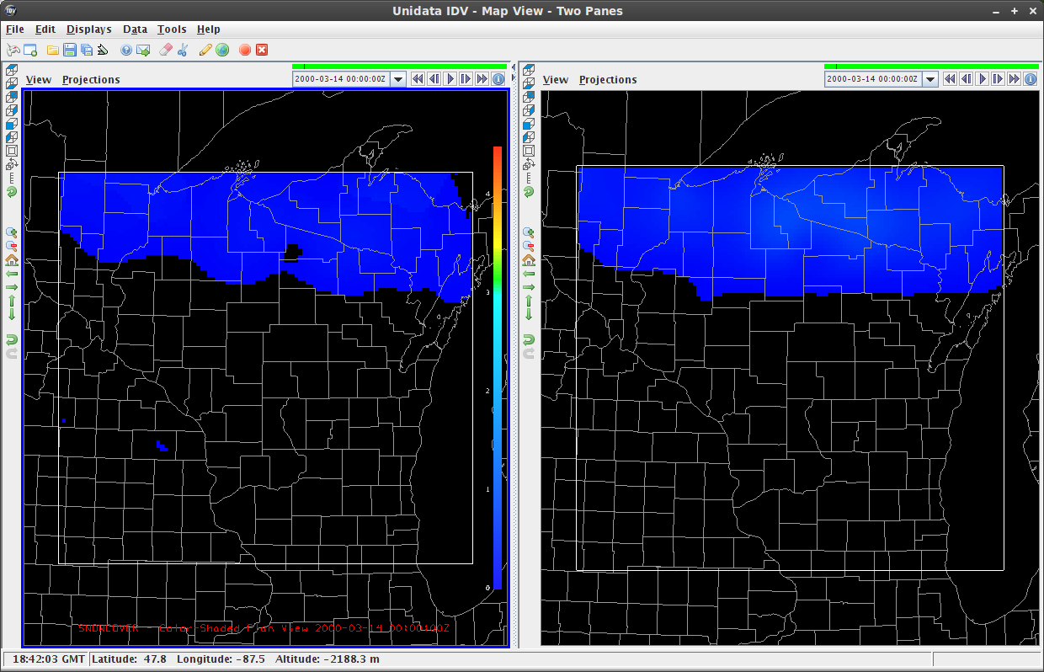
swb designed to work with PEST
January 10, 2000
January 23, 2000
SWB
Observed
SWB
Observed
February 25, 2000
March 14, 2000
SWB
Observed
SWB
Observed

Slide 18
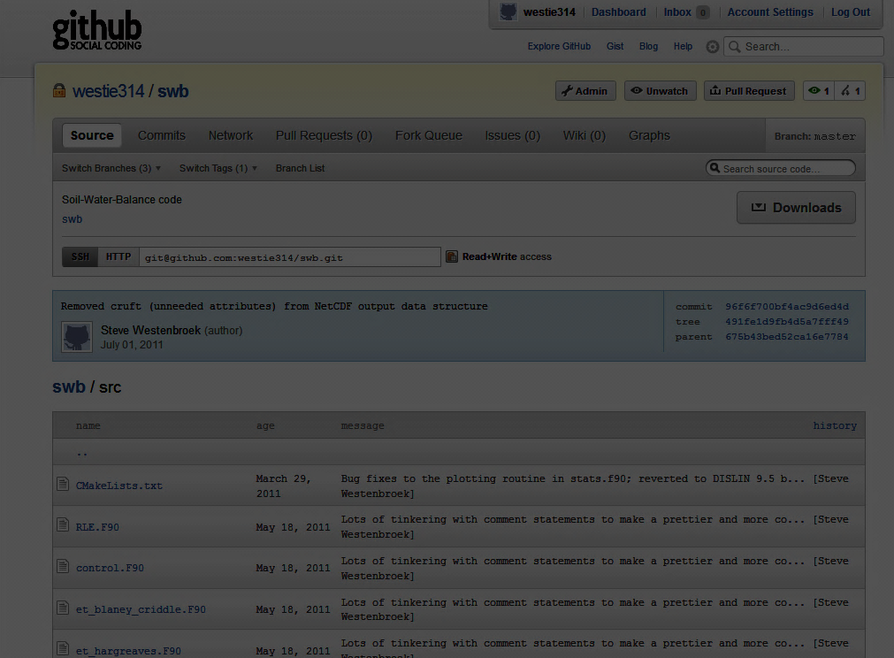
swb was designed to be easily modified!

Slide 19
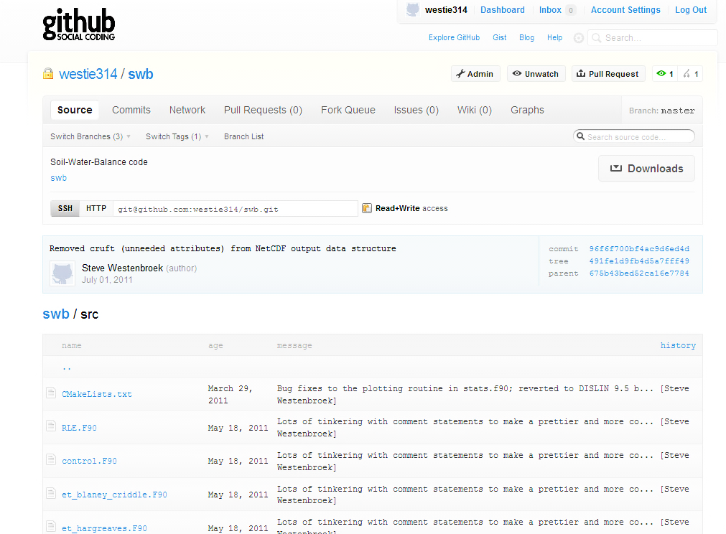
Current version: ported to Fortran 95/2003
Co-conspirators:
Wes Dripps
Randy Hunt
Vic Kelson
Ken Bradbury

Slide 20
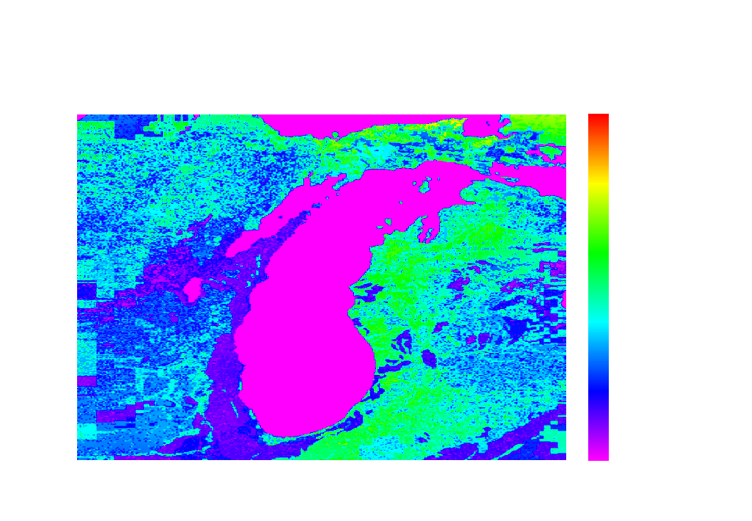
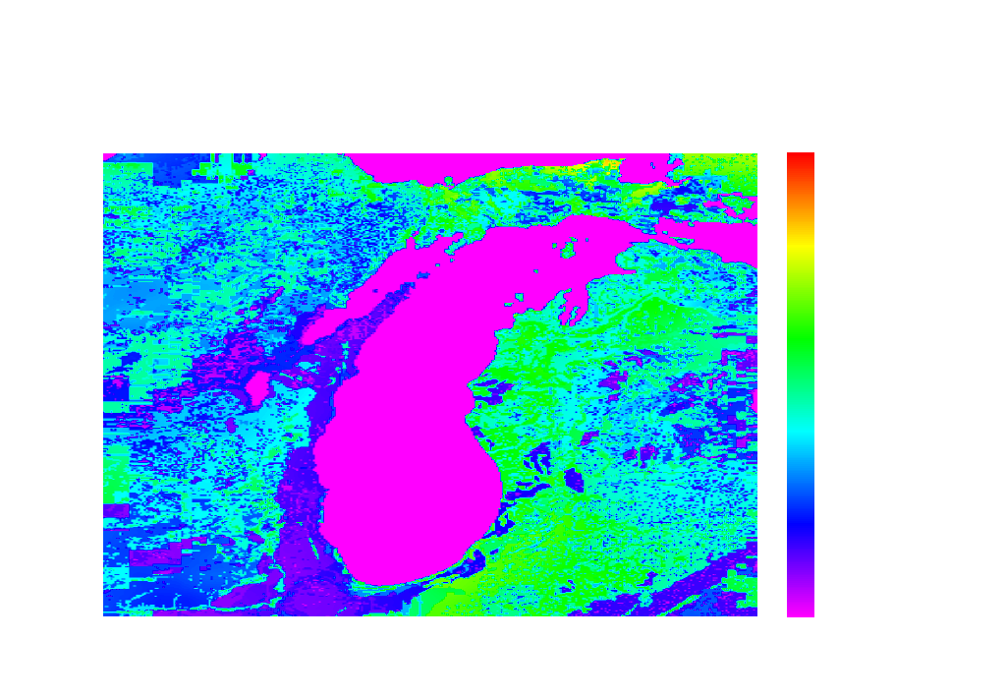
Mean Annual Recharge: 1901-2000
1992 Land Use
Mean recharge
(excluding open water):
6.94 inches
“Predevelopment” Land Use
Mean recharge
(excluding open water): 7.34 inches

Slide 21
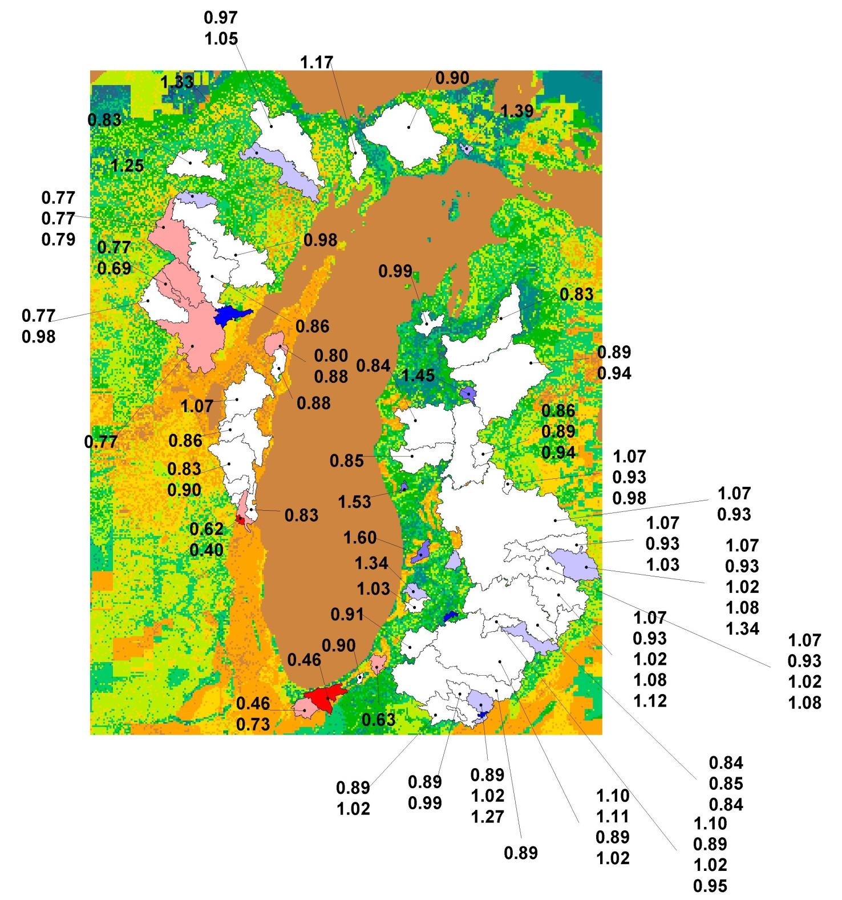
Ratio: SWB to Qb (Q90 regression)

Slide 22
Percentiles summary for 8 August 2007 – Run #2

Slide 23
swb was able to do a reasonable job matching Q90-based recharge estimates
LAND USE TYPES
21: low-density residential
41: deciduous forest
81: Pasture / grassland
82: Row crops
91: Forested wetland

Slide 24

swb estimates for Wisconsin; used to drive (in part) Wisconsin stream temperature model
Mean annual recharge for the period 1989-2000

Slide 25
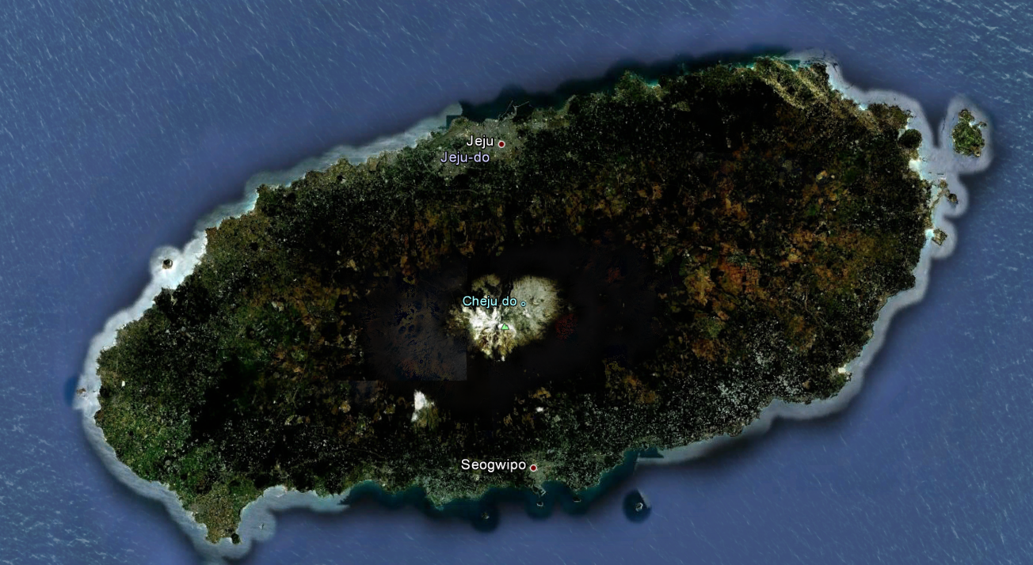
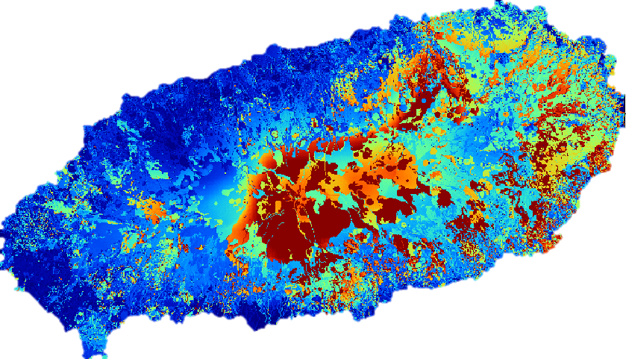
Je-ju Island, South Korea

Slide 26
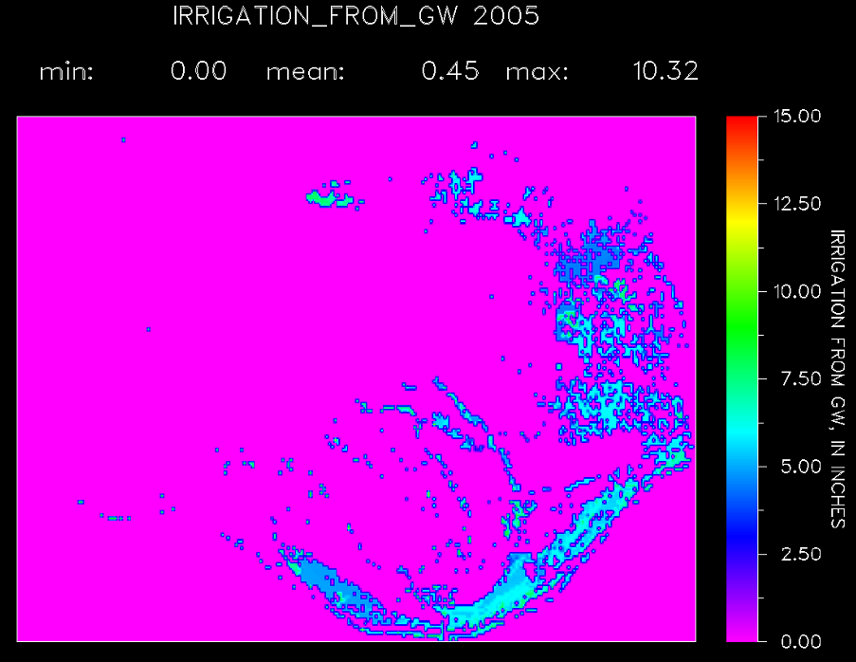
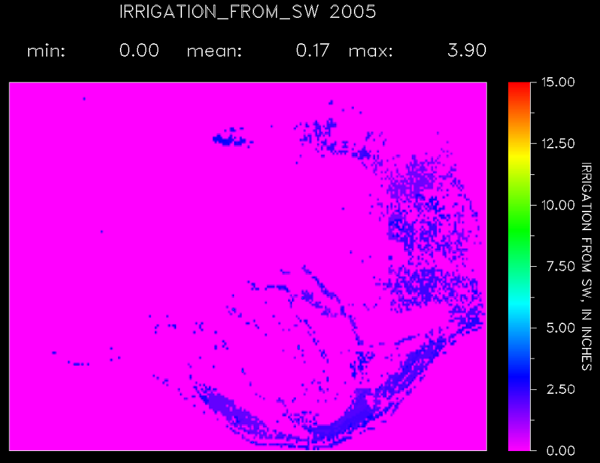
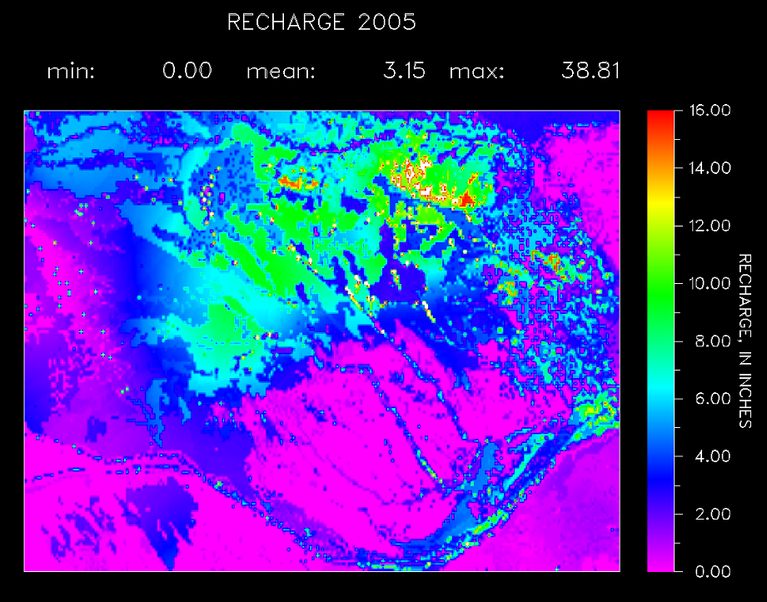
swb: irrigation demand

Slide 27
negatives? what negatives!
somewhat onerous to create gridded climate data
curve number hydrology has a long tradition of being panned in the literature
interception mechanism may be double-counting in certain cases
run times ~ (grid dimensions)**2

Slide 28
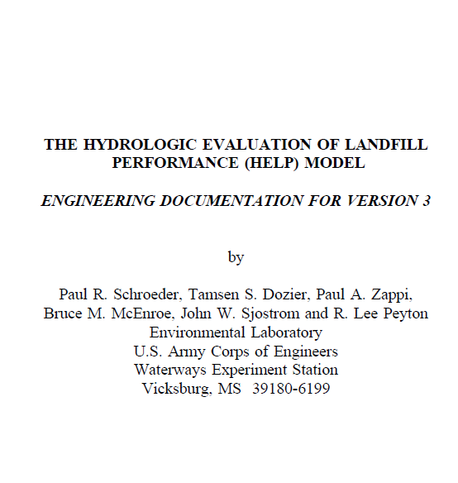
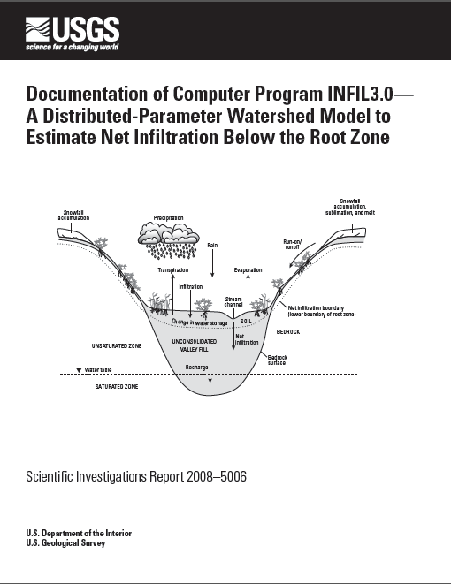
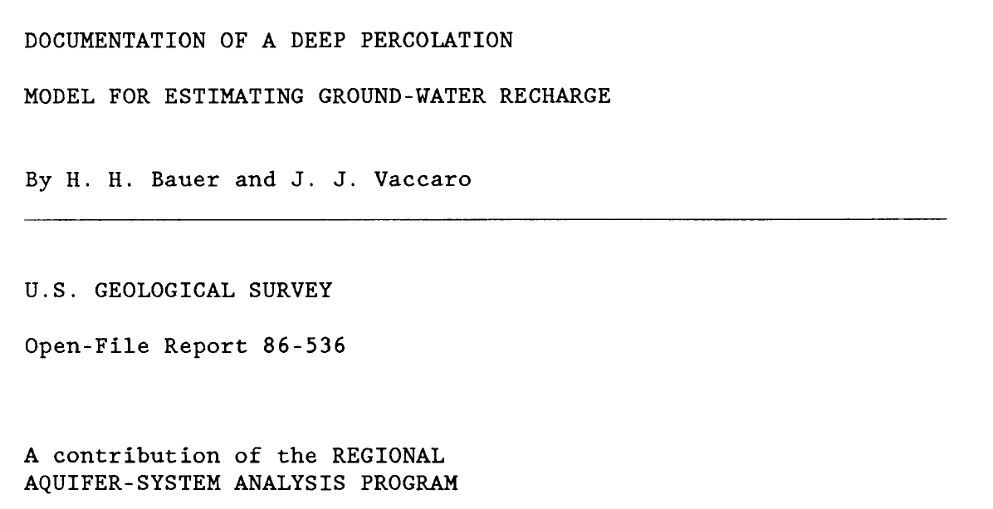
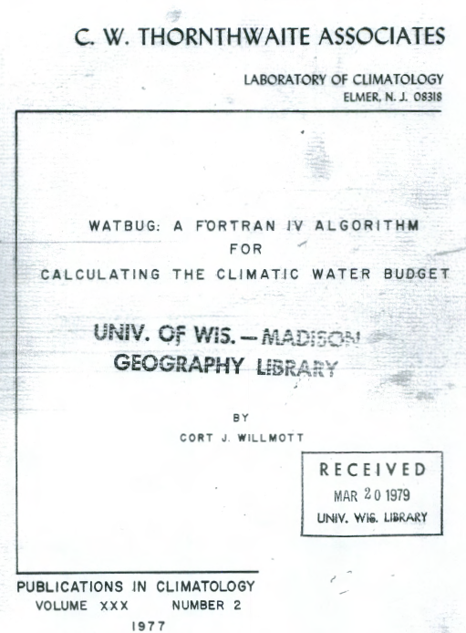

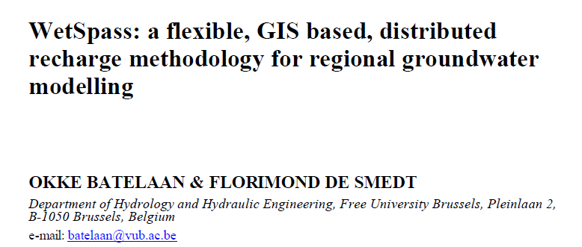
many existing tools for estimating potential recharge

Slide 29
 | Basin Charac-teristics | INFIL 3.0 | WetSpa | HELP (v3) | Deep Percolation | Versatile Soil Moisture Budget | SWB
Soil layers |  | Multiple (6) |  | Multiple | Multiple | Multiple | Single
Grid-based | Yes | Yes | Yes | No | Yes | Yes | Yes
Interception |  | NA |  |  | Bucket | NA | Simple bucket (empties daily; doesn’t affect ET)
Infiltration / Runoff |  |  |  |  | Curve number, modified by observed Q | Modified curve number | Curve number
Interflow |  |  | Darcy’s Law / kinematic approx. |  | NA |  | NA
Irrigation demand |  | NA |  | NA | User supplies application rates |  | Calculated by FAO-56 methodology
Soil moisture |  |  | Modified Thornthwaite-Mather |  | Mass balance w Zahner (1967) soil moisture retention fxns |  | Thornthwaite-Mather / FAO-56
Snow sublimation, drifting, etc. |  |  |  |  | Yes | Yes | No
Snowfall/Snowmelt
Runoff from frozen ground |  |  |  |  | NA |  | CFGI and Curve Number modification
Runoff routing |  | Yes |  | No | No |  | Yes
Potential Evapotranspiration |  | Priestly-Taylor |  |  | Jensen-Haise
Vegetation modulates AET |  |  |  |  | Yes (crop coefficient) | Yes (crop coefficient) | No; Yes (crop coefficients)

Slide 30
 | Basin Charac-teristics | INFIL 3.0 | WetSpa | HELP (v3) | Deep Percolation | Versatile Soil Moisture Budget | SWB
Climate data:
Interpolated on-the-fly (if gridded)? |  | Yes. Multiple regresssion / IDW |  | NA | Yes. Variety of ways to interpolate climate data. |  | No. Must be pregridded.
Landuse data |  |  |  |  | Dynamic (annual) |  | Dynamic (annual)
Grid-based | Yes | Yes | Yes | No | Yes | No | Yes
Maximum grid dimension |  | 60,005 |  | NA | ? Can likely be recompiled with greater dimensions |  | Limited by available memory (> 100,000)
GIS Data (GRIDS) as input? |  |  |  |  | No | ??? | Yes
NetCDF files as input? |  |  |  |  | No | ??? | Yes
Timescale | Monthly | Daily / hourly |  |  | Daily | Daily | Daily
Other |  |  | ArcView 3.3 extension |  | Several routines are tailored to the Pacific NorthWest

Slide 31
comparison with other tools…
many other good tools out there
all of these models (more or less) do the same thing—perform a mass balance on one or more oil layers in order to estimate recharge
preference may be dictated by the need for a specific mechanism
ease of use definitely a concern with some of the models
unlimited budget? apply more than one!

Slide 33
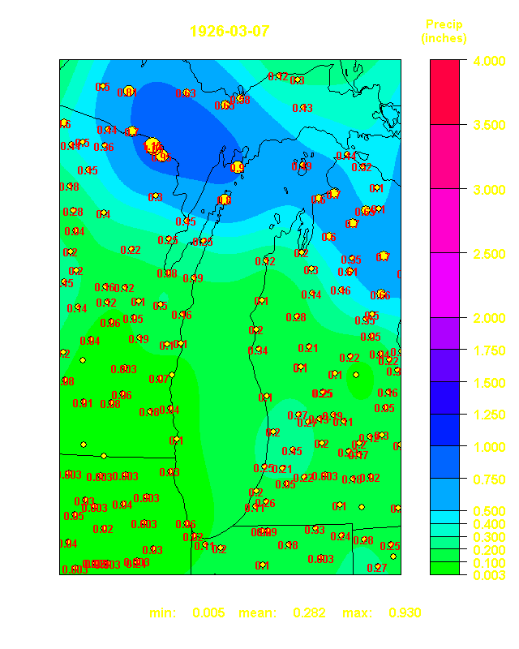
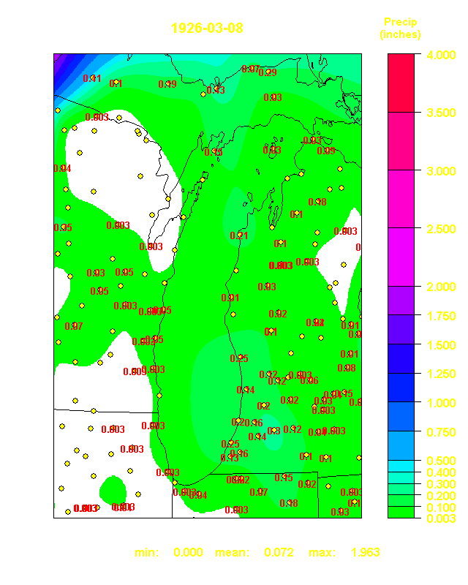
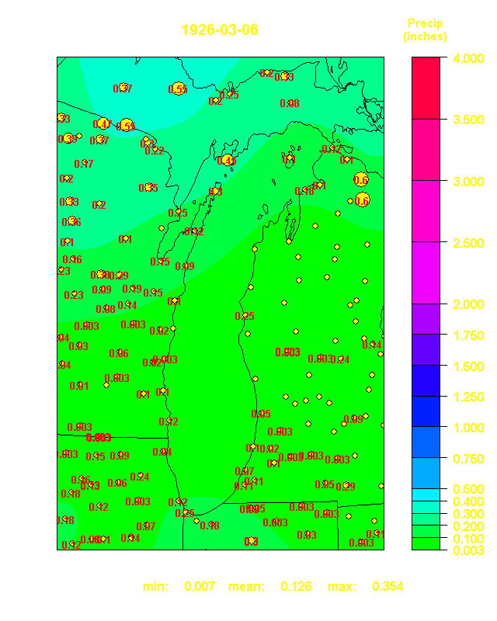
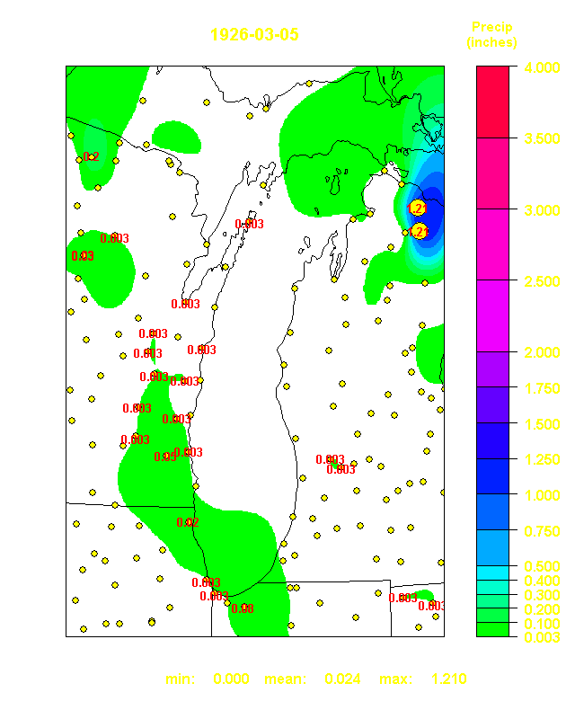
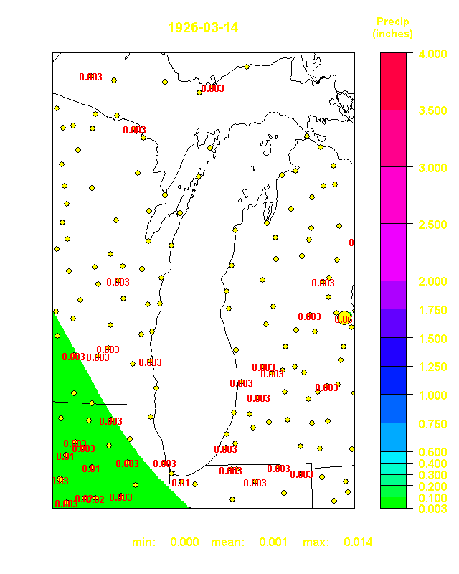
swb needs a better way of obtaining gridded daily climate data!

Slide 34
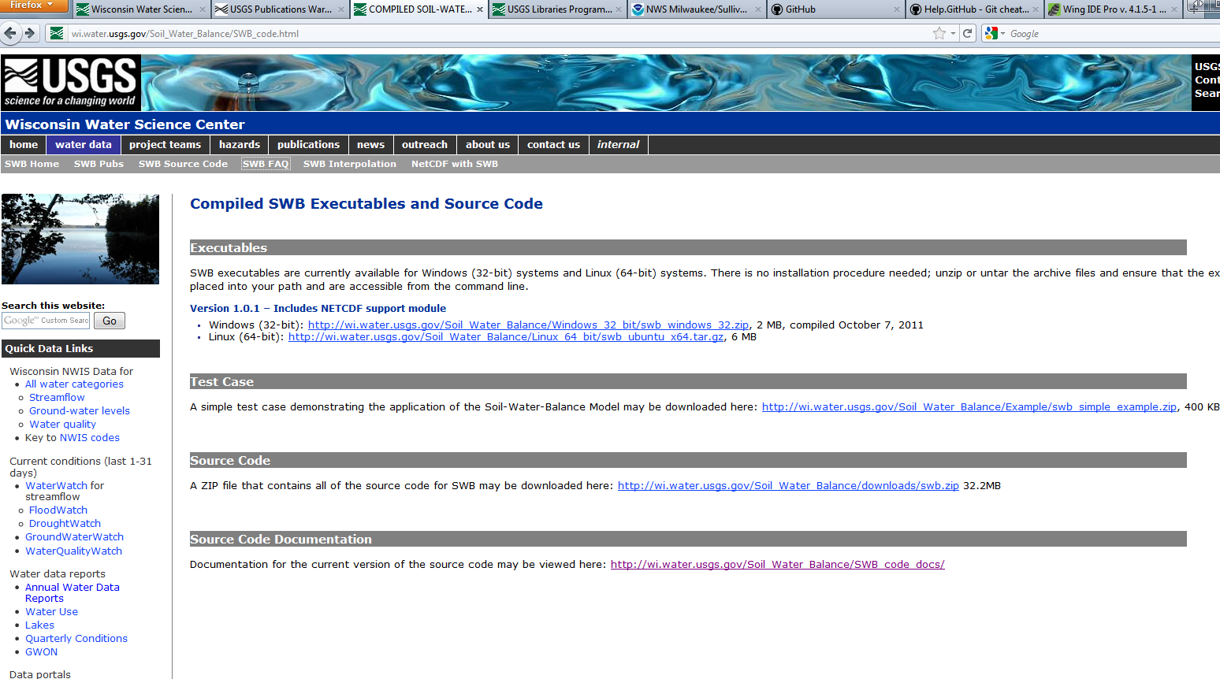
swb on the web…

Slide 35
The future of swb?
All programs evolve until they can send email.
- Richard Letts
Mean annual recharge for the period 1989-2000

Slide 36


Initial SWB-derived recharge
USGS gage-derived recharge
(Gebert and others, 2007)
Mean annual recharge for the period 1989-2000
Mean annual recharge for various periods, usually 1970-2000

Slide 37

Units: millions of acre-feet per year

Slide 38


Units: millions of acre-feet per year

Slide 39



Slide 40
Mean Annual Recharge: 1900-2000
“MEAN RECHARGE”: landuse = 1992 National Land Cover Dataset
“PREDEV MEAN RECHARGE”: landuse = composite vegetative land cover from surveyor’s records – ~1835 - ~1870
“URBAN CN MEAN RECHARGE”: landuse= 1992 NLCD; CN for high-density and low-density urban set to 92 and 86,
regardless of soil type, on theory that urbanized areas have disturbed, compacted soils that little resemble their
underlying soil hydrologic groups. (Lim and others, 2006, “Effects of initial abstraction and urbanization on estimated runoff
using curve number technology”, Journal of the American Water Resources Association, June, 2006.)

Slide 41
Mean Annual Recharge: 1900-2000

Slide 42
Je-ju Island, South Korea

Slide 43

Land cover as interpreted from survey records ~ 1820’s through 1850’s

Slide 44

Land cover – National Land Cover Dataset (1992)

Slide 45




1945
1955
1965
1975
Irrigated corn and soybeans shown in purple

Slide 46

swb needs better tools for munging output

Slide 47
Summary for 8/8/2007 SWB run #2
Alternative INITIAL ABSTRACTION method used (Hawkins, 2002); Ia = 0.05S
Continuous Frozen Ground Index (CFGI) = 83
Hargreaves (1985) PET
Curve numbers dynamically linked to antecedant moisture condition (i.e. as originally coded)
Flattened curve numbers for urban areas (i.e. single curve number for all soil types; reflective of compacted nature of urban soils)
Land use grid eliminates all open water cells save for Lake Michigan AND Lake Winnebago
Overland flow routing in SWB was disabled for all pilot project simulations
Simulation period covered January 1, 1989 through December 31, 2000
Model domain consisted of 316 cells by 410 cells, 5000 ft in length on each side

Slide 48
Percentiles summary for 8 August 2007 – Run #2

Slide 49
Regression summary for 8 August 2007 – Run #2
Source data: SWB run 8 AUG 2007 v2

Slide 50
Summary of estimated recharge by land use: 8 AUG 2007 – Run #2
Source data: SWB run 8 AUG 2007 v2

Slide 51
Summary of mean estimated POTENTIAL RECHARGE by land use and soil type
SOIL TYPE
Source data: SWB run 8 AUG 2007 v2

Slide 52
Summary of AWC times rooting depth by land use and soil type
AWC: Available Water Capacity (inches of water per foot of soil depth)
All things being equal, recharge is roughly α 1 / (AWC times rooting depth)
AWC values applied to Fullerton soil types:
1) CLAY TILL: 3.4 inches
2) LOAMY TILL: 2.2 inches
3) FINE STRATIFIED: 3.0 inches
4) MEDIUM and COARSE STRATIFIED: 1.4 inches
5) ORGANIC: 2.0 inches
Source data: SWB run 8 AUG 2007 v2

Slide 53
Curve numbers used for 8/8/2007 Run #2

Slide 54
Root zone depths (ft) by AWC used for 8/8/2007 Run #2
SOIL AVAILABLE
WATER CONTENT
(INCHES PER FOOT)

Slide 55


Soils layer used for 8 August SWB Run #2

Slide 56


Land use classification layer used in 8 August 2007 Run #2
Notes:
Daniel and Randy: here is a simple way arounf the issue that Daniel and I discussed this morning: convert “OPEN WATER” cells to “WOODY WETLAND”. That is not to say that each of these cells is truly representative of woody wetland, but it will force SWB to calculate a midrange recharge value rather than kicking out zero recharge. Probably not a bad approximation for northern MI and WI.

Slide 57


Available Water Capacity layer used for 8 August SWB Run #2

Slide 58


Root depth times AWC for 8 August SWB Run #2

Slide 59

Precipitation and temperature inputs to the SWB code
Data from 250 NOAA cooperative climate stations pulled for the period 1989-2000
Interpolations made for each day of the simulation period
Thin plate spline interpolations performed on daily minimum and maximum air temperature and precipitation data
Each daily interpolation saved as an ASCII Arc GRID file for use as input to the soil water balance code (> 3650 files)

Slide 60




Example Soil Moisture Balance Inputs and Outputs - 1994

Slide 61



Final recharge grid: average of 1991-2000 annual estimates
Unfiltered
Multidirectional Lee Filter
Source data: SWB run 8 AUG 2007 v2

Slide 62
References
J. S. Lee. Digital image enhancement and noise filtering by use of local statistics.
IEEE Transactions on Pattern Analysis and Machine Intelligence, PAMI-2:165-168, 1980.

